Slide 1
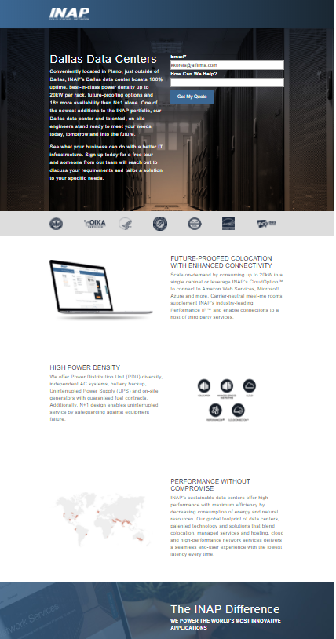



INAP – Marketing Managed Service
Business Need
INAP, a global leader in providing high-performance IT infrastructure services, was looking for assistance with the development, implementation and support of a long-term marketing plan to expand brand awareness and customer engagement as well as increase lead generation via solid inbound and outbound marketing tactics.
Although INAP has an internal marketing team, they wanted to leverage a strategic partner that could assist with a multitude of marketing tasks as needed, offer best practices and recommendations based on experience working with a variety of clients and execute work in a timely fashion.
What We Did
Affirma worked with INAP to fully understand their business and sales/marketing goals as well as performed document reviews and audits to define, set and prioritize marketing objectives, strategies and tactics. Deliverables during the initial start-up phase included specific recommendations regarding tactics, such as SEO, AdWords, social media and marketing automation as well as process improvements, such as governance and lead management.
Affirma continues to support INAP’s team through an ongoing monthly managed service agreement.

Slide 2
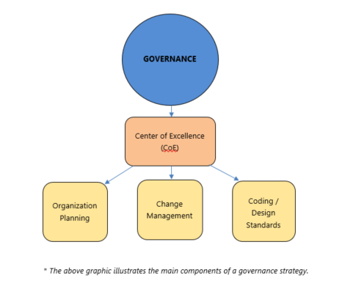
INAP – Company Rebrand & Marketing Fundamentals
Business Need
INAP recently transitioned from Internap to INAP, so one of the first tasks involved re-establishing brand awareness, improving brand reputation and formerly documenting marketing fundamentals. This work would involve updating their style guide, redesigning their main website; evaluating and revising buyer personas and implementing governance.
What We Did
Affirma performed an extensive heuristic evaluation of INAP’s website, including competitor analysis, in order to provide detailed findings and recommendations for improved site-wide navigation and header/footer UX. Design comps were provided as well.
In addition, Affirma provided the following:
  Governance Strategic Framework
  Naming Convention Specification
  Lead Management Procedure and process documents
  Style Guide best practices
  Buyer Persona workshops and recommendations

Slide 3
INAP – Demand Gen: SEO/SEM
Business Need
INAP was looking to maintain their SEO value while transitioning their domain name from internap.com to inap.com as well as increase lead generation. As such, they needed a detailed process for the domain change and support with their search engine marketing (SEM) tactics.
What We Did
Affirma provided a step-by-step domain change strategy for INAP’s web development team, specifically how to minimize the impact to SEO. The Affirma team also performed a full SEO audit and then implemented best practices and recommendations, including meta description updates, back link management and set up of the Google Search Console for indexing. In addition, local SEO was set up for Google and Bing maps.
Affirma performed a keyword and competitor analysis to develop a comprehensive Pay-Per-Click (PPC) Google and Bing AdWords strategy well as retargeting strategy. Implementation included creating campaigns and landing pages as well as setting up appropriate tracking code.
Affirma continues to support INAP’s team with their SEO/SEM efforts.

Slide 4

INAP – Demand Gen: Social Media & Content Creation
Business Need
In addition to SEO/SEM to further demand gen activities, INAP also wanted more efficient social media management and an increase in value-added blog content to generate more leads.
What We Did
Affirma developed a detailed social media action plan, which called out specific recommendations for INAP’s Facebook, Twitter, Pinterest, LinkedIn, YouTube and Google+ accounts. Affirma also identified a social media management platform, Buffer, to simplify management and reporting of social accounts.
Finally, based on topics provided by INAP, Affirma researches and writes approximately two articles per month for their blog.

Slide 5

INAP – Marketing Automation: Pardot
Business Need
INAP utilizes Pardot for their marketing automation cloud-based service and didn’t feel they were getting the most out of the platform. They wanted an evaluation of their current usage and ongoing support to better leverage the tool.
What We Did
Affirma performed an in-depth audit of the platform, and provided best practices and recommendations for configuration and usage.
The Affirma creative and development team designed and built new templates within Pardot, including landing page, thank you page, email and newsletter templates. The aim was to preserve as much of the ‘drag and drop’ Pardot functionality as possible to make editing easier and more efficient. Upon building, Affirma updated all the autoresponder emails with the new template.
Affirma’s custom development team also created a two-column form, which is not native Pardot functionality that INAP can now use on landing/website pages.
Finally, Affirma prepared an email deliverability and bounce management document pertaining to Pardot to improve sending and reduce bounces.
Affirma continues to support INAP’s team with Pardot and will be implementing Engagement Studio and nurture campaigns.

